Slide 1
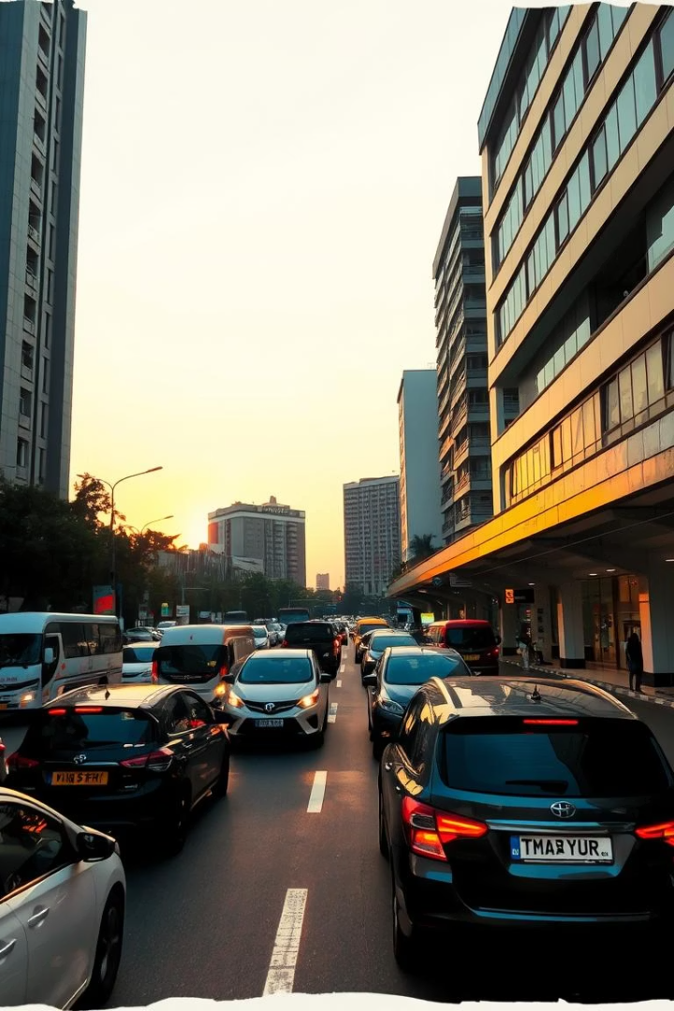
Predicting Bangalore's Traffic Volume with Regression Models
Leveraging weather and time data, we develop models to forecast traffic volume accurately. This aids traffic management and urban planning in Bangalore.

Slide 2
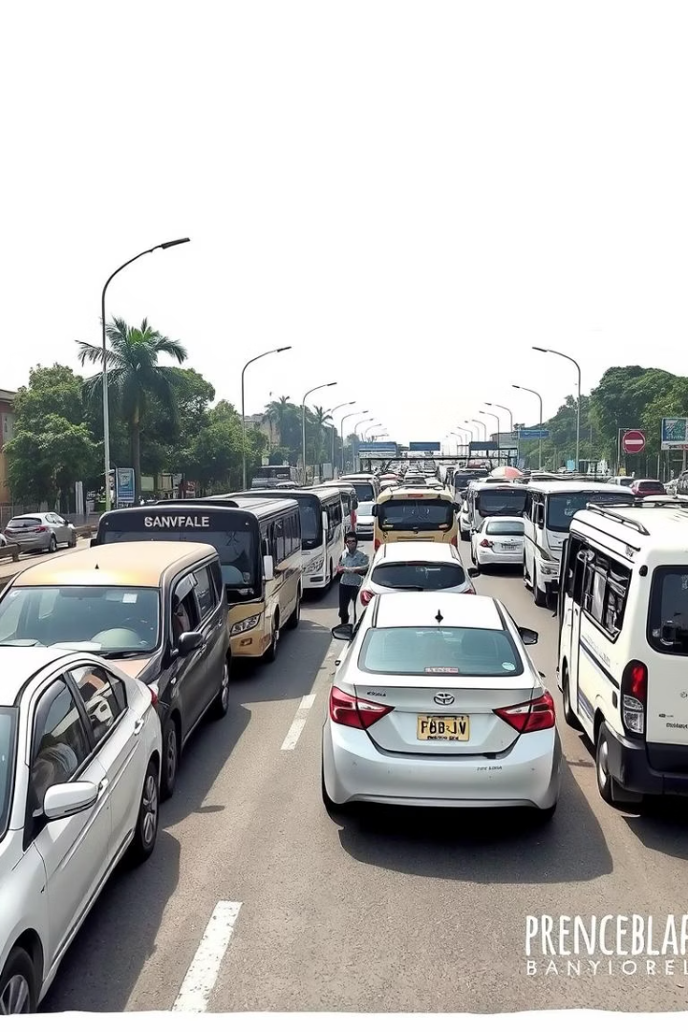
Project Overview: Addressing Bangalore's Traffic Woes
Traffic Congestion
Project Goal
Bangalore faces worsening traffic delays and pollution challenges daily.
Predict traffic volumes using advanced regression models for improved planning.
Impact
Reduce congestion and commute times via data-driven traffic management.

Slide 3

Data Sources: Weather and Time Variables
Traffic Data
Weather Data
Temporal Data
Sourced from Bangalore Traffic Police Department (2023-2024).
Collected via OpenWeatherMap API: temperature, humidity, rainfall.
Includes hour, day of week, month, and holiday info for better context.

Slide 4

Feature Engineering: Crafting Predictive Variables
Cyclical Time Features
Lagged Traffic Variables
Interaction Terms
Sine and cosine transforms for hour, day, and month improve prediction.
Combining weather and time boosts model relevance and accuracy.
Previous hour's traffic helps capture temporal dependencies.

Slide 5



Regression Models: Selection and Training
Linear Regression
Baseline model for establishing benchmark predictions.
Random Forest
Captures complex non-linear patterns effectively.

Slide 6
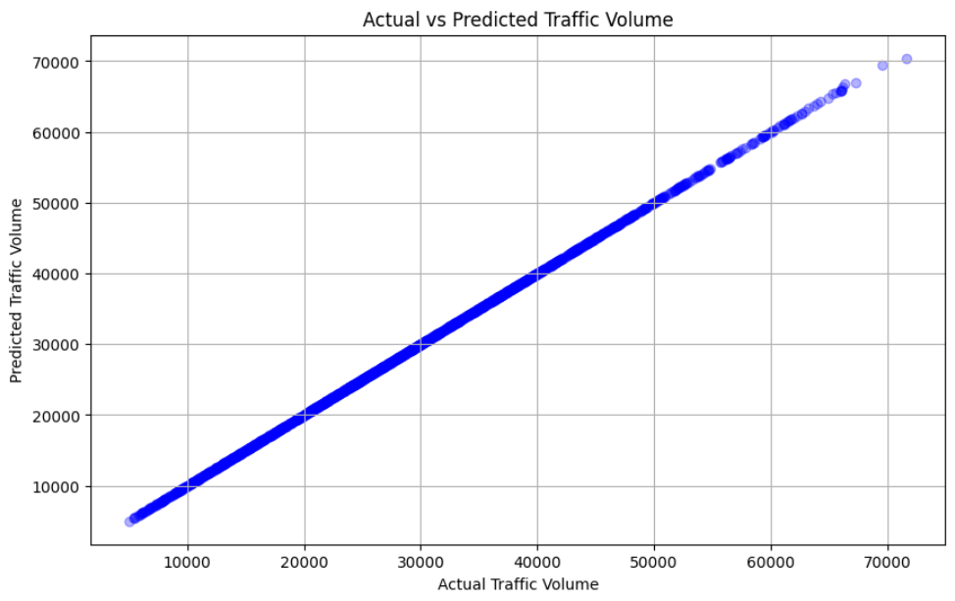
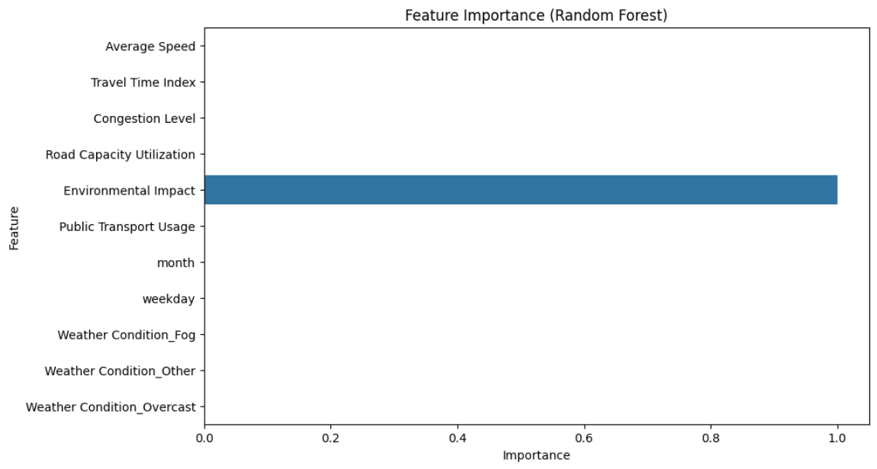
Model Performance: Accuracy and Validation
1
Training & Validation Split
Data divided into 80% training and 20% validation sets to assess model fit.
2
Cross-Validation
Ensures robustness and generalization across data subsets.
3
Performance Metrics
R-squared
MAE (Mean Absolute Error)
RMSE (Root Mean Squared Error)
4
XGBoost Result
Achieved an R-squared of 0.85, indicating strong predictive power.

Slide 7
Case Studies: Real-World Traffic Scenarios
Rainfall Impact
Holiday Traffic
Congestion Hotspots
Traffic predictions during sudden rain events for dynamic management.
Forecasting patterns for Diwali and other major holidays.
30% increase in traffic near Electronic City flyover during peak hours.

Slide 8
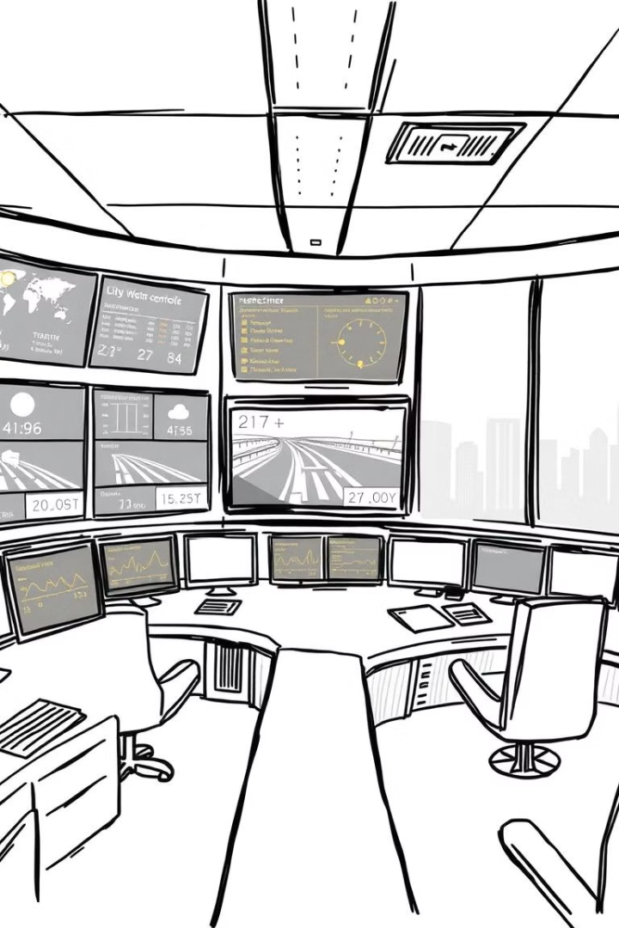




Implications for Traffic Management and Planning
Signal Adjustments
Proactively modify traffic lights based on forecasted volumes.
Public Transport
Optimize routes and schedules according to predicted congestion.
Real-Time Alerts
Send traffic and congestion warnings to commuters.
Tech Integration
Potential links with Google Maps and traffic apps for wider reach.

Slide 9
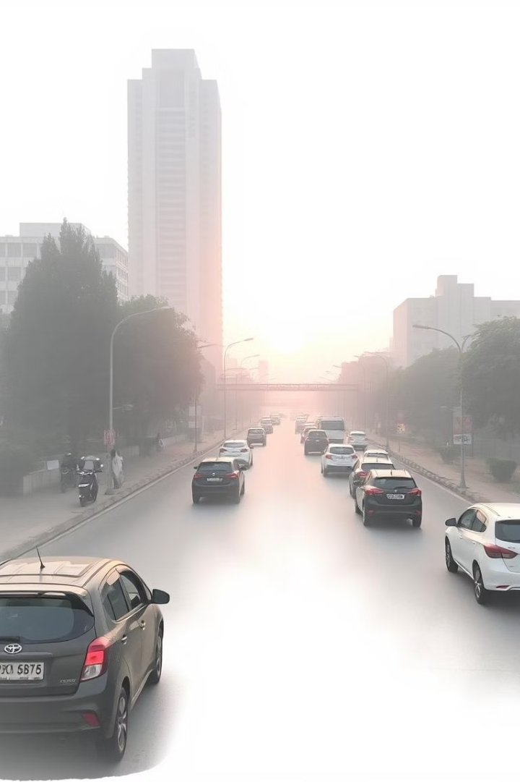
Conclusion: Data-Driven Solutions for Bangalore's Traffic
Accurate Forecasting
Regression models reliably predict traffic using weather and time data.
Strategic Insights
Enables smarter management and urban planning decisions.
Future Directions
Include real-time sensors and broaden geographic coverage.

